Slide 1
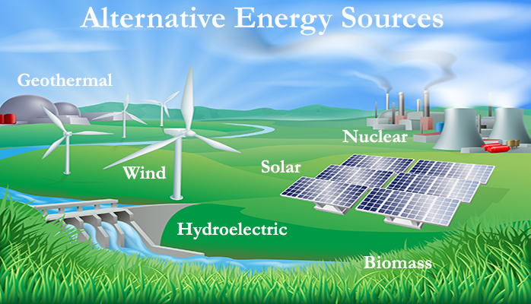
RENEWABLE ENERGY

Slide 2
RENEWABLE SOURCES:-
SOLAR ENERGY
GEOTHERMAL ENERGY
NON-RENEWABLE SOURCES:-
COAL,COKE
NUCLEAR GAS
WIND ENERGY
TIDAL ENERGY
PETROLEUM AND ITS DERIVATIVES
NUCLEAR FUEL
WAVE ENERGY
OCEAN THERMAL ENERGY
BIOGAS

Slide 3
Need for Renewable Resources
In the current scenario, the demand of fossil fuels is ever increasing. The globe is being affected very badly because of the emission of harmful gases by these fuels.
Recent statistics state that if global warming continues at the same rate, then there would be 4 degree Celsius rise in the global temperature by 2100. Also India has overtaken America which was then the second largest producer of sulphur dioxide. This is very alarming and so we have tried our best to give a small contribution to save the nature.

Slide 4
ADVANTAGES AND DISADVANTAGES OF RENEWABLE SOURCES OF ENERGY:-
ADVANTAGES:- | DISADVANTAGES:-
1. They have minimal impact on the environment. | 1.They contain energy in diluted form.
2.They are widely available. | 2. But, availability is uncertain or periodic.
4.Renewable energy facilities generally require less maintenance than traditional generators. | 3. It is difficult to generate the quantities of electricity that are as large as those produced by traditional fossil fuel generators.
4.They are non polluting. | 4. Their collection is expensive.

Slide 5
SolAR ENERGY
iNTRODUCTION
'Solar' is a Latin word for the sun and Energy is the ability to do work. So, we can define solar energy as energy obtained from the sun.
Nuclear fusion reactions taking place in the sun giving rise to electromagnetic radiations. 45% of these radiations, are absorbed by the earth.
One of the basic and natural use of solar energy is photosynthesis.
Solar energy is radiant light and heat energy from the Sun that is harnessed using a range of ever-evolving technologies such as solar heating, photovoltaics, solar thermal energy, solar architecture, molten salt power plants and artificial photosynthesis.

Slide 6
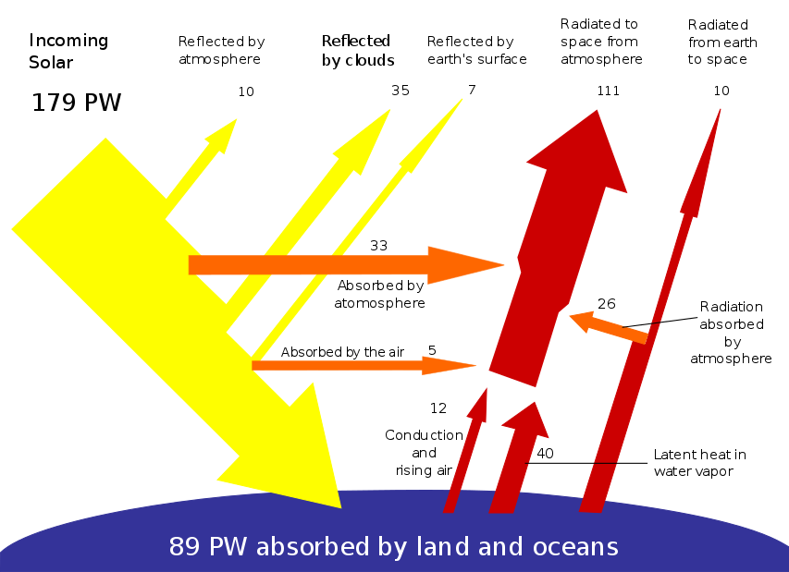

Slide 7

Reasons for using Solar energy:-
Solar energy is a major renewable energy source with the potential to meet many of the challenges facing the world.
1) Solar Power Is Good for the Environment
2) Combats Climate change
3)Solar Power Causes Less Electricity Loss

Slide 8
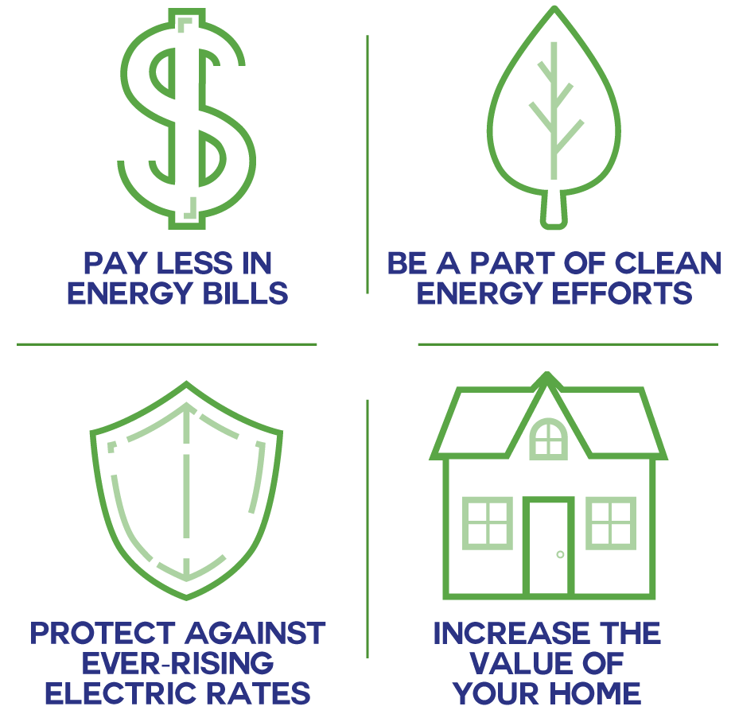
Advantages of Using Solar Energy
Renewable energy source available free of cost
Clean and pollution free
The source does not deplete with use
Available naturally in every consumer’s premises

Slide 9
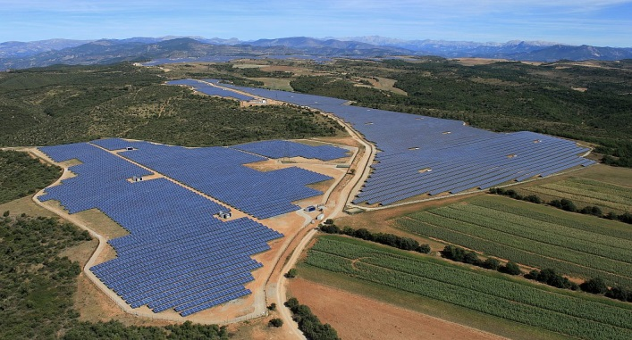

LIMITATIONS OF USING SOLAR ENERGY:-
Uneconomical
Weather Dependent
Solar Energy Storage Is Expensive
Uses a Lot of Space
Still in developmental stage

Slide 10
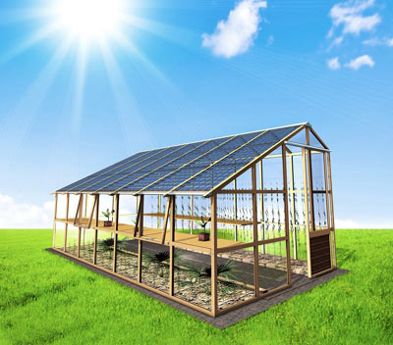
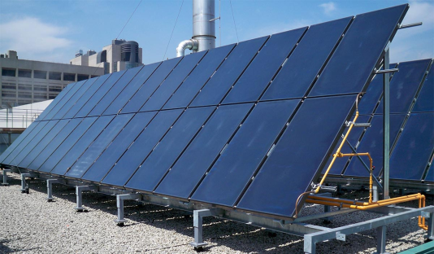
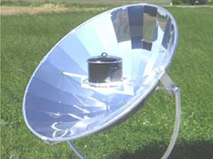
APPLICATIONS OF SOLAR ENERGY:-
Solar domestic heating purposes.
Solar cooking.
Electricity generation.
Solar thermal power production.
Solar furnaces.
Solar green houses.
Driving force for batteries

Slide 11
Solar Heating
No conversion equipment or complex collection required for domestic heating
Simple principle of black body principle (solar panels), flat plate collectors are used.
SOLAR HEATING SYSTEMS
ACTIVE HEATING SYSTEMS.
PASSIVE HEATING SYSTEMS.

Slide 12
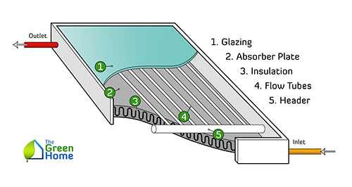
FLAT PLATE COLLECTOR:-

Slide 13
It is a common type of solar “panel” is one that is used strictly for heat production, usually for heating water
Consists of a black (or dark) surface behind glass that gets super-hot in the sun
Upper limit on temperature achieved is set by the power density from the sun
dry air may yield 1000 W/m² in direct sun
using σT⁴, this equates to a temperature of 364 °K for a perfect absorber in radiative equilibrium (boiling is 373 °K)
Trick is to minimize paths for thermal losses

Slide 14
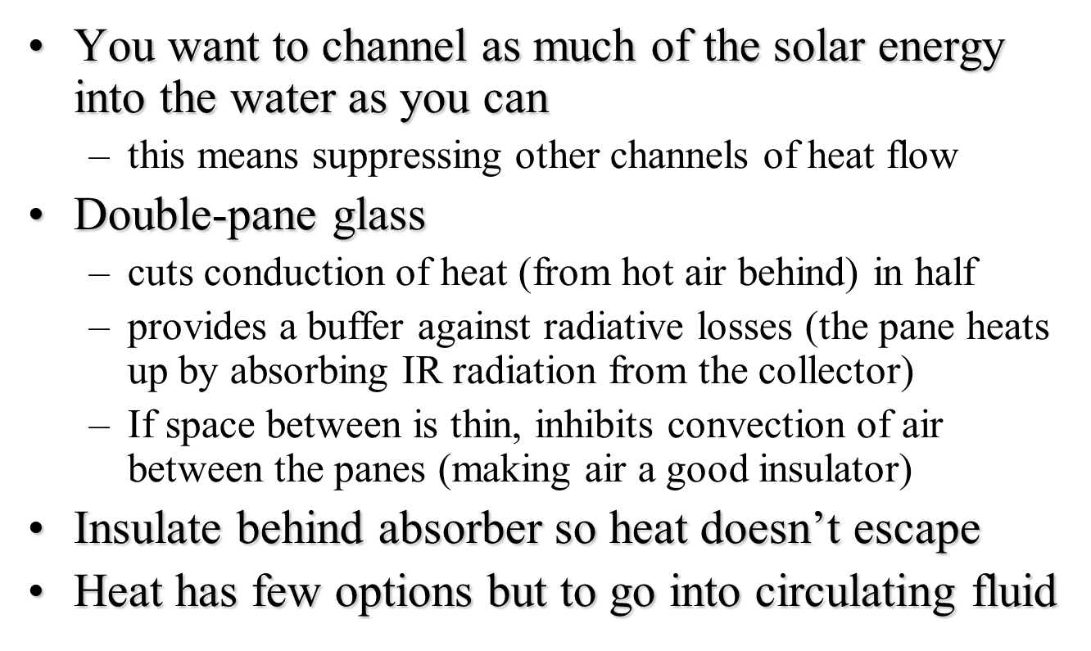

Slide 15
Glass is transparent to visible radiation (aside from 8% reflection loss), but opaque to infrared radiation from 8–24 microns in wavelength
collector at 350 °K has peak emission at about 8.3 microns
inner glass absorbs collector emission, and heats up
glass re-radiates thermal radiation: half inward and half outward: cuts thermal radiation in half
actually does more than this, because outer pane also sends back some radiation: so 2/3 ends up being returned to collector

Slide 16
Efficiency-
Two-pane design only transmits about 85% of incident light, due to surface reflections
Collector is not a perfect absorber, and maybe bags 95% of incident light (guess)
Radiative losses total maybe 1/3 of incident power
Convective/Conductive losses are another 5–10%
Bottom line is approximately 50% efficiency at converting incident solar energy into stored heat
0.85×0.95×0.67×0.90 = 0.49

Slide 17
Domestic use-
Typical showers are about 10 minutes at 2 gallons per minute, or 20 gallons.
Assume four showers, and increase by 50% for other uses (dishes, laundry) and storage inefficiencies:
20×4×1.5 = 120 gallons ≈ 450 liters
To heat 450 l from 15 ºC to 50 ºC requires:
(4184 J/kg/ºC)×(450 kg)×(35 ºC) = 66 MJ of energy
Over 24-hour day, this averages to 762 W
At average insolation of 200 W/m² at 50% efficiency, this requires 7.6 m² of collection area
about 9-feet by 9-feet, costing perhaps $6–8,000

Slide 18
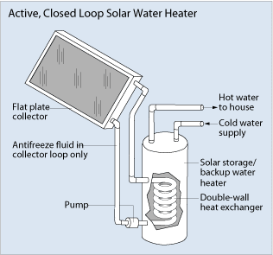
Active heating system
Active systems use one or more pumps to circulate water and/or heating fluid. This permits a much wider range of system configurations.
Easily controlled and higher efficiency
Features like safety functions, remote access ,informative displays, backup, etc make it expensive

Slide 19
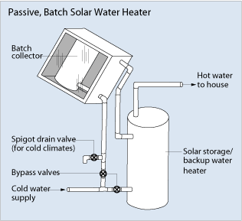
Passive heating system:-
Relies on natural convection for circulation
Less expensive than active systems
More reliable and may last longer

Slide 20
Production Of Electricity
Photovoltaic cell
Solar trough collector

Slide 21
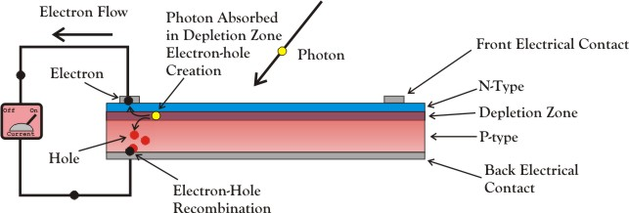
Photovoltaic Cells:-

Slide 22
Sunlight impinges on silicon crystal
Photon liberates electron
Electron drifts aimlessly in p-region
If it encounters junction, electron is swept across, constituting current
Electron collected at grid, flows through circuit (opposite current lines)
Utility grid
PV-array
Inverter
Sun Light
DC
AC
Battery
Sunlight is turned into DC voltage/current by PV
Can charge battery (optional)
Inverted into AC
Optionally connect to existing utility grid
AC powers household appliances

Slide 23
A solar cell, or photovoltaic cell , is an electrical device that converts the energy of light directly into electricity by the photovoltaic effect, which is a physical and chemical phenomenon
Solar cells are described as being photovoltaic, irrespective of whether the source is sunlight or an artificial light. They are used as a photodetector for detecting light or other electromagnetic radiation near the visible range, or measuring light intensity.
The operation of a photovoltaic (PV) cell requires three basic attributes:
The absorption of light, generating either electron-hole pairs or excitons.
The separation of charge carriers of opposite types.
The separate extraction of those carriers to an external circuit.

Slide 24
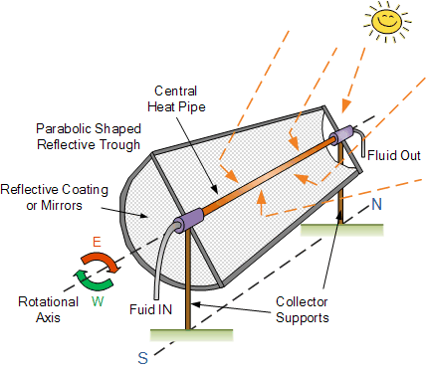
Solar Trough Collector

Slide 25
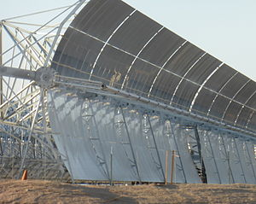
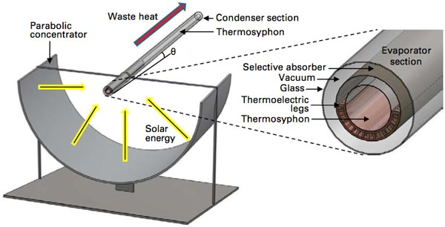
A parabolic trough is a type of solar thermal collector that is straight in one dimension and curved as a parabola in the other two, lined with a polished metal mirror. The energy of sunlight which enters the mirror parallel to its plane of symmetry is focused along the focal line, where objects are positioned that are intended to be heated.

Slide 26
SOLAR PLANTS IN INDIA
KAMUTHI SOLAR POWER PROJECT, TAMIL NADU: ONE OF THE LARGEST IN INDIA. OUTPUT: 648 MW
CHARANKA SOLAR PARK, GUJARAT: LARGEST IN ASIA AND SECOND LARGEST IN THE WORLD.
HYBRID PLANT, LEH, JAMMU & KASHMIR.
SINGLE AXIS TRACKER SOLAR PLANT, VELLAKOIL,TN.

Slide 27
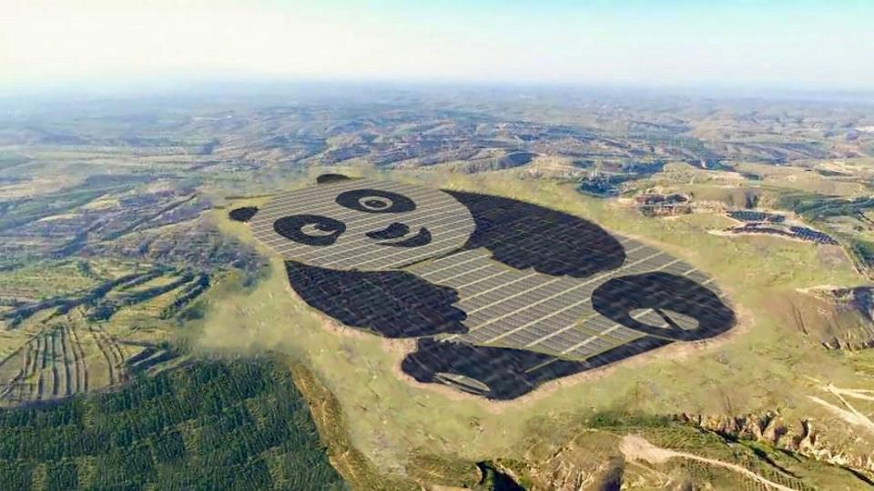
Panda Solar farm Datong, China
250Acre, 100MW Mega Project

Slide 28
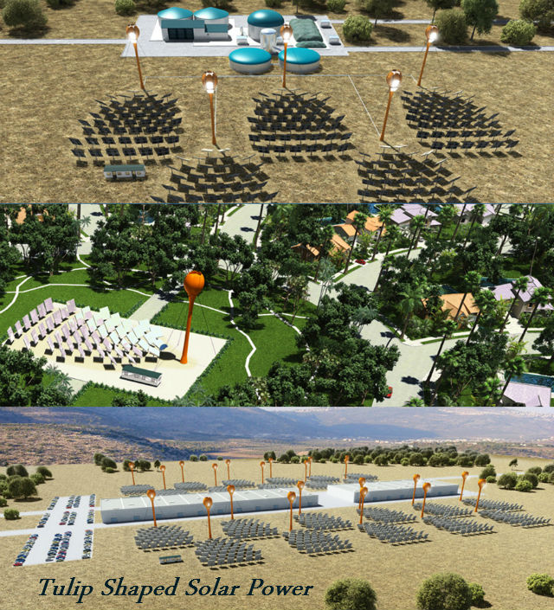
Advanced Technologies in Solar Energy Harnessing
AORA Solar came with this new concept of harnessing the solar energy. It has begun the construction of this solar-biogas power plant in Ethiopia. The concept is inspired by the Sunflower, by creating the Solar Panel that faces the Sun

Slide 29
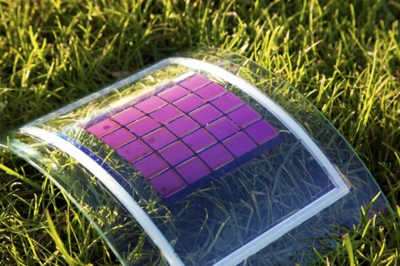
Innovation in Solar Cells
Organic solar cells:-
Made of titanium dioxide instead of silicon.
Silicon is a limited resource while TiO2 is available in plenty.
TiO2 is cheaper than silicon.
Organic solar cells can be made in normal conditions of temperature and pressure while normal solar cells require vacuum conditions for manufacturing.
Efficiency is greater.

Slide 30
